Slide 2
Comparison between Deep Learning and Machine Learning
Machine Learning | Deep Learning
A subset of Artificial intelligence that include abstruse statistical techniques to enable machines improve at task with experience. | A subset of machine learning composed of algorithms that permits software to train itself to perform task, by exposing multilayered neural network to vast amount of data.
Can have a single neuron layer. | Must have more than one layer of neurons.
Requires less computing power with greater human intervention. | Requires high computing power with less human intervention.

Slide 3
Advantages and disadvantages of MATLAB in Deep learning.
Advantages | Disadvantages
Invaluable for signal processing. | Huge pain to use for anything that isn’t simply represented as a numeric feature matrix
Incredibly broad array of useful libraries | Lacking a good open-source ecosystem
Simplest and most concise language for anything involving matrix operations | MATLAB is not suggested to make any product. Because MATLAB doesn’t create application deployment like task (like setup files and other executable which copies during installation).
Simulink package provides almost complete libraries hence no need for third party libraries. | Cross compiling or converting MATLAB to other language code is very difficult.

Slide 4
Advantages and disadvantages of Python in Deep learning.
Advantages | Disadvantages
Very fragmented but comprehensive scientific computing stack. | Slow since it is an interpreter language.
IPython notebook makes a nice interactive data analysis tool. | Some of the scientific computing stack is still stuck in Python 2.7
Very good for problems that don’t come as a simple feature matrix, between tools like pandas. | When using Python, you are required to install extra third-party packages.
Have a good open-source ecosystem.

Slide 5
Can MATLAB accept Python Codes and/or Python Code accept MATLAB codes? State some examples (if any)? Search about that in the internet?
MATLAB provides a flexible, two-way integration with Python.
Call Python from MATLAB
You can access Python libraries directly from MATLAB by adding the py. prefix to the Python name.
Examples include; Use Python Numeric Variables in MATLAB and Use Python Tuple Variables in MATLAB.
Calling MATLAB from Python
The MATLAB Engine API for Python allows you to call MATLAB as a computational engine from Python. The API lets you execute MATLAB commands from within your Python environment without starting a desktop session of MATLAB.
Examples include Call MATLAB in python

Slide 6
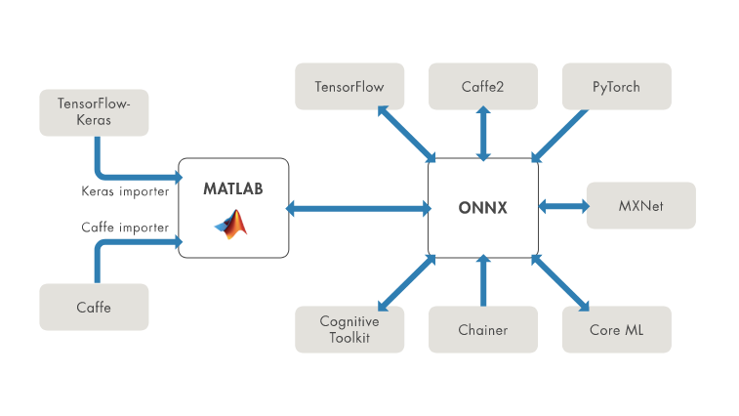
Is it possible to use Tensor flow and Keras environments in MATLAB software?
MATLAB supports importing and exporting open-source deep learning frameworks with the Open Neural Network Exchange (ONNX) format.
We can import models directly from TensorFlow and PyTorch.
Fig 1. ONNX Format model.

